Slide 1
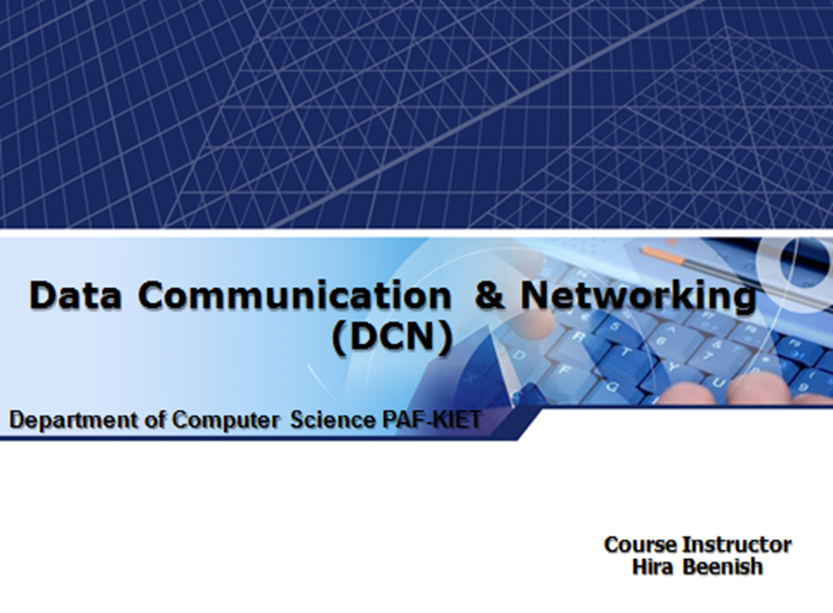

Slide 2

Chapter 4. Digital Transmission
4-1

Slide 3
Digital-to-digital conversion
How to represents digital data by using digital
signals.
Three techniques used in the conversion
❑ Line coding
❑ Block coding
❑ Scrambling

Slide 4
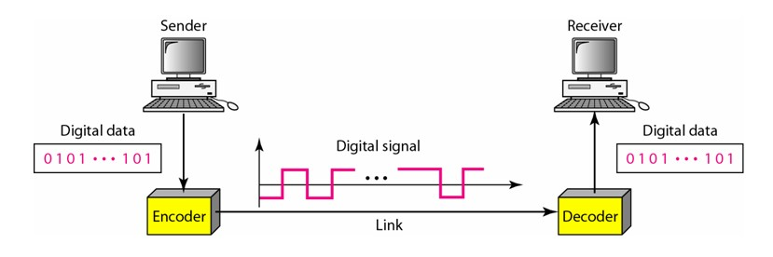
Line Coding
Line coding is the process of converting digital data to digital signals.
Data (text, numbers, graphical image, audio, video etc) are store d in computer memory as sequence of bits.
Line coding converts a sequence of bits to a digital signal.
At the sender, digital data are encoded into digital signal; at the receiver, the data are recreated by decoding the digital signal.

Slide 5
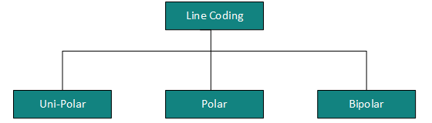
Line Coding
Line coding scheme can be divided into five broad categories :

Slide 6
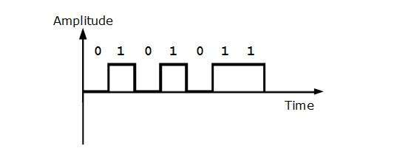
Unipolar Scheme
In a unipolar scheme, all the signal levels are on one side of the tim e axis; either above or below.
NRZ (Non-Return-to-Zero) scheme
Designed so that positive voltage defines bit 1 and the zero voltage defines bit 0.
It is called NRZ because the signal does not return to zero at the middle of the bit.

Slide 7
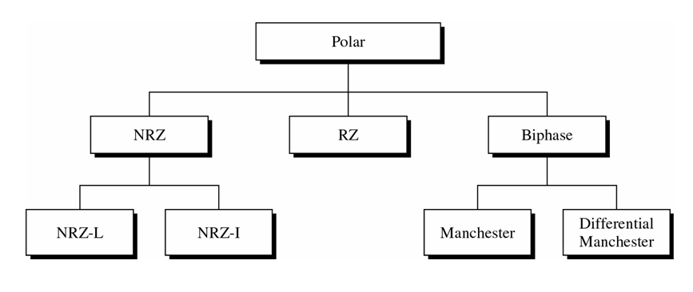
Polar Scheme
In a polar scheme, the voltages are on both sides of the time axis.

Slide 8
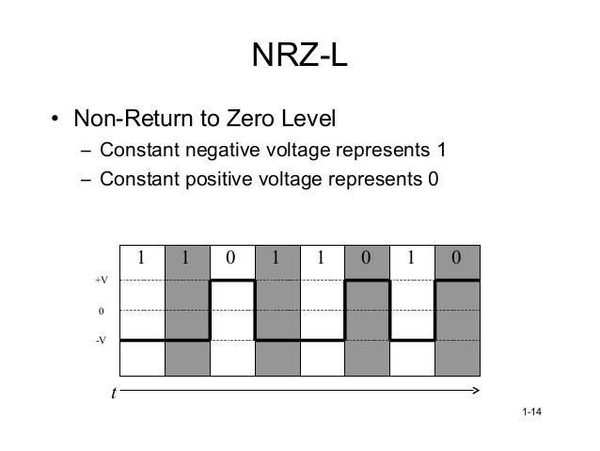
NRZ
NRZ-L (Non Return to Zero-Level) – Level of signal depends on the type of bit it represent
s. A positive voltage means

Slide 9
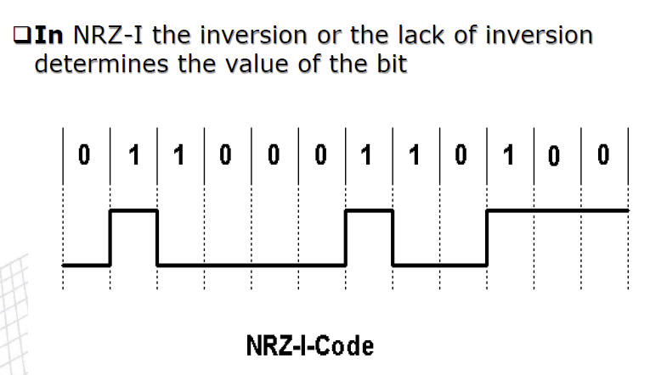
NRZ-I

Slide 10
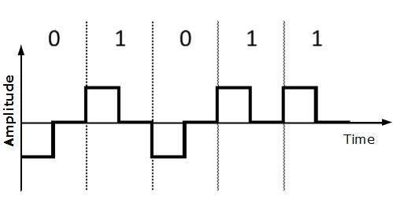
Polar Scheme : RZ
Signal changes during each bit
Uses Three values (+, -, 0) are used
– Bit 1: positive-to-zero transition, bit 0: negative-to-zero transition

Slide 11
Polar Scheme : Biphase
Combination of RZ and NRZ-L/NRZ-I ideas
Signal transition at the middle of the bit is used for synchronization
Manchester (combine RZ & NRZ-L)
Bit 1: negative-to-positive transition
Bit 0: positive-to-negative transition
Differential Manchester (combine RZ & NRZ-I)
Bit 1: no transition at the beginning of a bit
Bit 0: transition at the beginning of a bit

Slide 12
Bipolar Scheme
Three levels of voltage, called “multilevel binary”
Bit 0: zero voltage, bit 1: alternating +1/-1
AMI (Alternate Mark Inversion) and pseudoternary
– No DC component

Slide 13
Block Coding
Block coding is a error control coding
To ensure accuracy of received data redunt bi ts are used
The decoder uses the redundant symbols to d etect and possibly correct whatever errors occ urred during transmission.

Slide 14
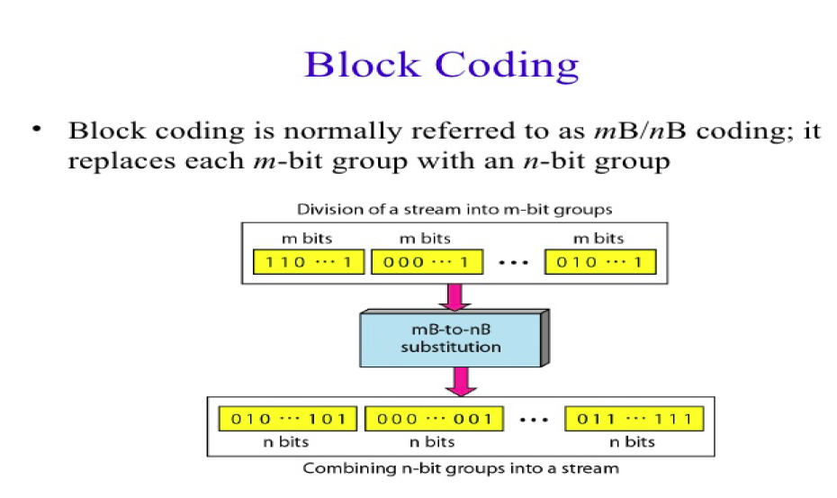
Block Coding

Slide 15
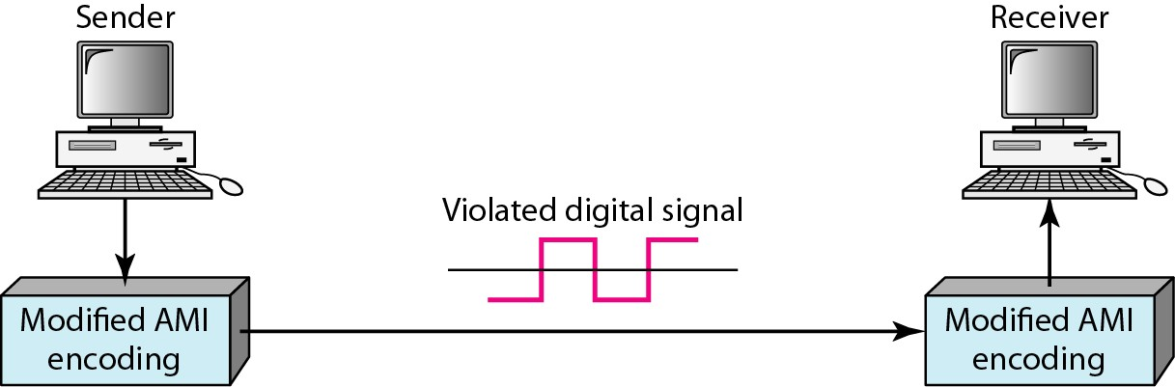
Scrambling
However long 0s upset the synchronization and not suitable for long distance.
Looking for a solution – a technique that does not increase t he number of bits and providing synchronization.

Slide 16
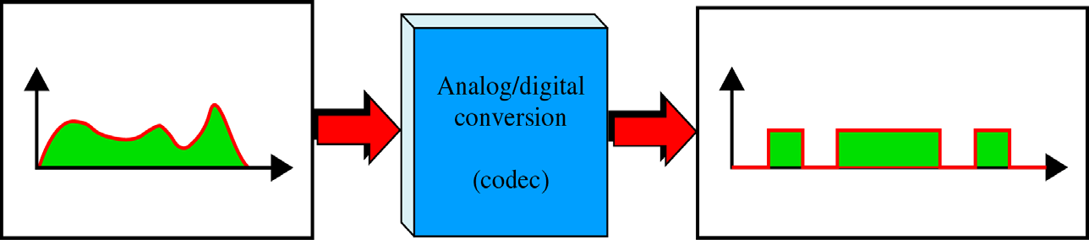
Analog-To-Digital Conversion
Analog information (e.g., voice) → digital signal (e.g., 10001011…)
Two techniques :
Pulse Code Modulation (PCM)
Delta Modulation

Slide 17
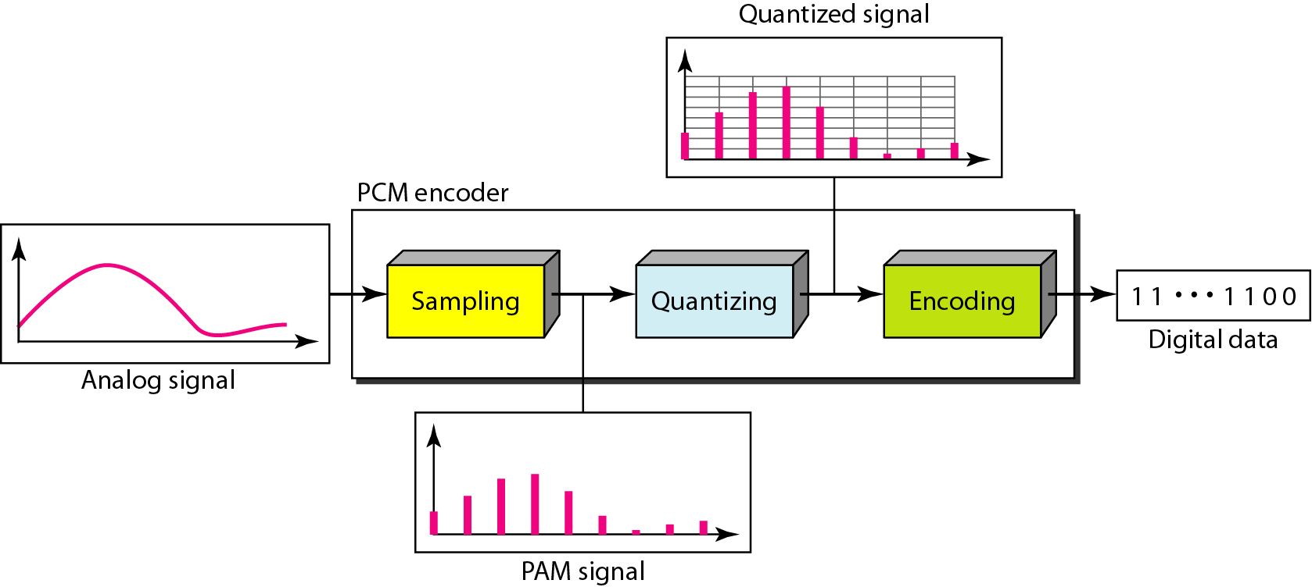
Pulse Code Modulation (PCM)
Three processes :
The analog signal is sampled
The sampled signal is quantized
The quantized values are encoded as streams of bits

Slide 18
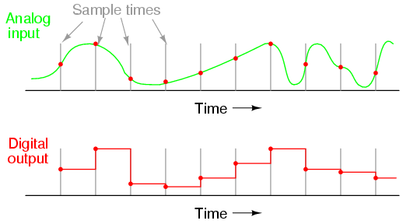
Pulse Code Modulation (PCM)
Sampling
The first step in PCM is sampling. The analog si gnal is sampled every Ts, where Ts is the sampl e interval or period

Slide 19
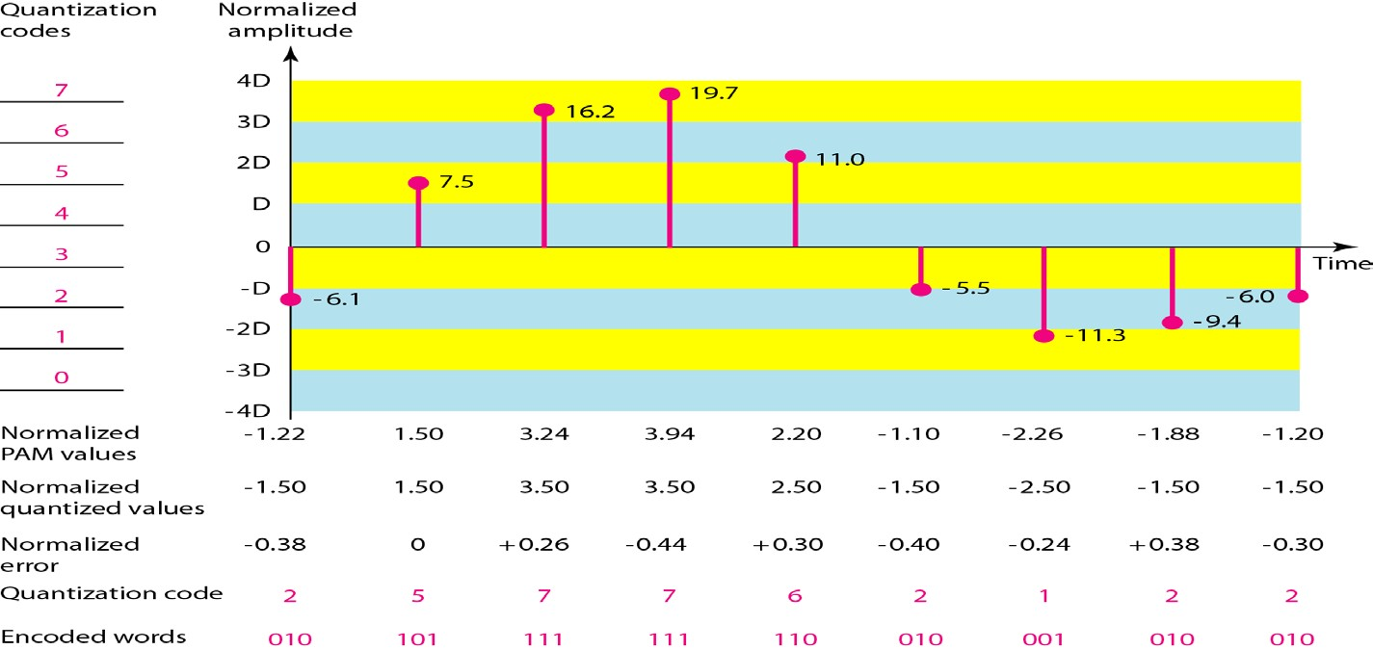
Pulse Code Modulation (PCM)
Quantization (Examples)
– Quantization is the process of converting a continuous range of values into a finite range of discreet values.

Slide 20
Pulse Code Modulation (PCM)
Encoding
After each sample is quantized and the number of bits per sample is decided, each sample is change d to an nb-bit codeword.
If the number of quantization levels is L, the num ber of bits is nb = log2L.
In Above Figure the encoded words are shown in
the last row. A quantization code of 2 is encoded as 010; 5 is encoded as 101; and so on
The bit rate can be found as
–
Bit rate = sampling rate × number of bits per sample = f_{s} × n _{b}

Slide 21
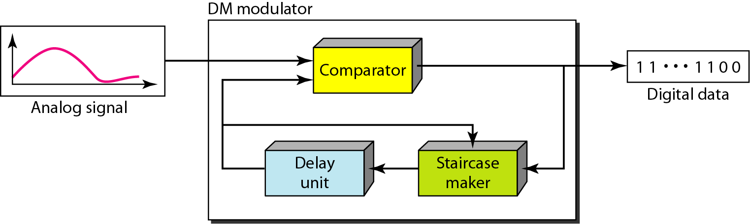
Delta Modulation
PCM is a very complex technique. Other techniques have been developed to reduce the complexity of PCM. The simplest is delta modulation

Slide 22
Delta Modulation
Modulator
The modulator is used at the sender site to create a stream of bits from an analog signal.
The process records the small positive or negative changes, called delta O.
If the delta is
positive, the process records a I; if it is negative, the process records a O

Slide 23
Delta Modulation
Modulator
The output of the comparator also makes the staircase itself; if the next bit is 1, the staircase maker moves the last point of the staircase signal δup, otherwise moves th e δdown.
A delay unit is used to hold the staircase function for a period between two compari sons.

Slide 24
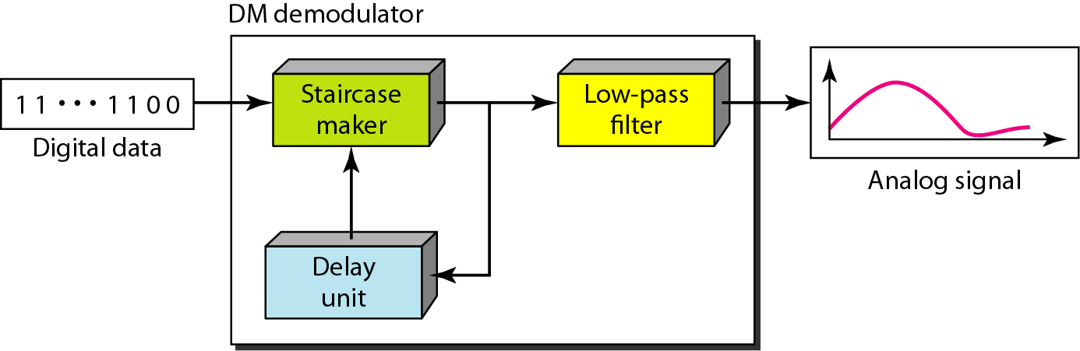
Delta Modulation
Demodulator
The demodulator takes the digital data, and using the staircase maker and the delay unit, creates the analog signal.
A low-pass filter is used to smoothen the signal.

Slide 25
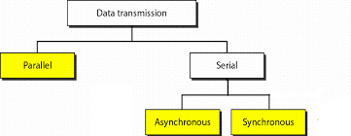
TRANSMISSION MODES
primary concern when we are communicating is the data stream. Do we send 1 bit at a time; or do we s end group of bits.

Slide 26
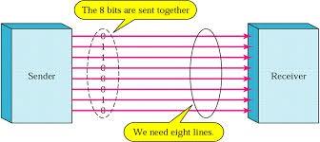
TRANSMISSION MODES
Parallel Transmission
The mechanism for parallel transmission is a con ceptually simple one: Use n wires to send n bits at one time. That way each bit has its own wire, and all n bits of one group can be transmitted fr om one device to another

Slide 27
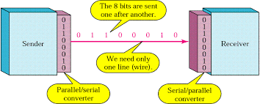
TRANSMISSION MODES
Serial Transmission
In serial transmission one bit follows another, so we need only one communication channel rather than n to transmit data between two communica ting devices

Slide 28
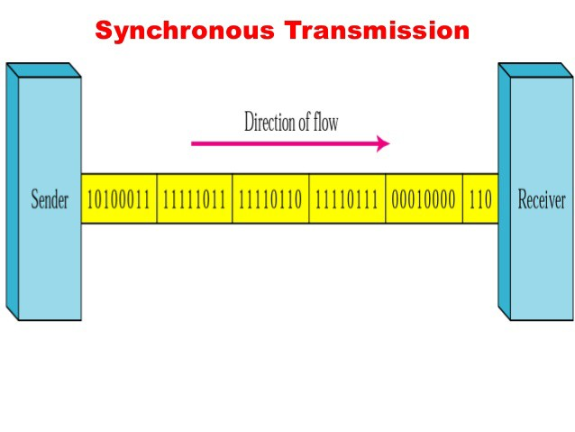
Serial Transmission
Synchronous Transmission
In synchronous transmission, we send bits one after another without start or stop bits or gaps.

Slide 29
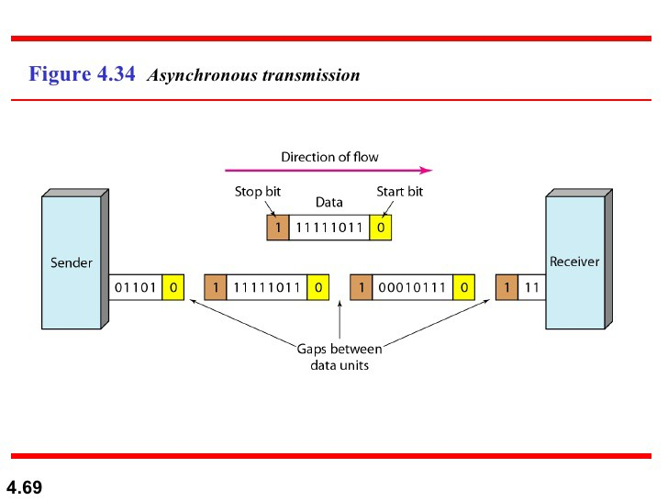
Serial Transmission
ASynchronous Transmission
In asynchronous transmission, we send 1 start bit
(0) at the beginning and 1 or more
stop bits (Is) at the end of each byte. There may be a gap between each byte.

Slide 30
Thank you

